Slide 1

Routing
Browser Routing
SoftUni Team
Technical Trainers
Software University
http://softuni.bg

Slide 2
Table of Content
Single Page Application
Routing Concepts
Navigation and History
Handling Forms

Slide 3
Have a Question?
sli.do
#js-advanced

Slide 4

Types of Web Applications
SPA, Multi Page

Slide 5
Multi Page Applications
Reloads the entire page
Displays the new page when a user interacts with the web app
when a data is exchanged, a new page is requested from the server to display in the web browser

Slide 6
Multi Page Pros and Cons
Pros
Performs well on the search engine
Provides a visual map of the web app to the user
Cons
Comparatively complex development
Coupled backend and frontend

Slide 7
Single Page Applications
A next evolution from multi-page website
Web apps that load a single HTML file
SPAs use AJAX and HTML5 to create fluid and responsive Web apps
No constant page reloads

Slide 8
Single Page Applications
Re-renders its content in response to navigation actions, without reloading of the page
Can use state from external source or track state internally
Internal state SPAs are limited - only one "entry"
With location-based SPAs, the location is always updating
Location-based SPAs need a special object "Router"

Slide 9
SPA Pros and Cons
Pros
Load all scripts only once
Maintain state across multiple pages
Browser history can be used
Better UX
Cons
Perform poor on the search engine
Server-side rendering helps
Provide single sharing link
Less secure

Slide 10

Multi Page Application Lifecycle
CLIENT
Initial Request
SERVER
Form Post
Page Reload

Slide 11

SPA Lifecycle
CLIENT
Initial Request
SERVER
AJAX

Slide 12

Navigation Types
Standard Navigation
Navigation using Routing - allows navigation, without reloading the page
Link
HTML
Link
Router
Link
Link

Slide 13
Query Parameters
Allow for additional application state to be serialized into the URL
Common use cases
representing the current page number in a paginated collection
filter criteria
sorting criteria

Slide 14
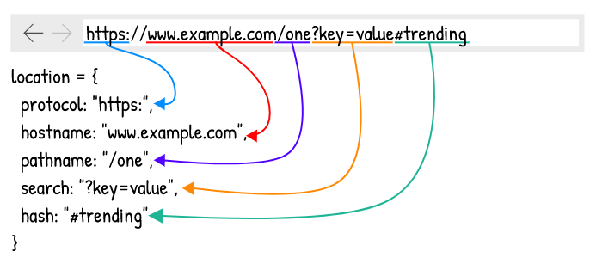
Location

Slide 15

Routing Concepts
Navigation for Single Page Apps

Slide 16
How Routers Work
A Router loads the appropriate content when the location changes
E.g. when the user manually enters an address
Conversely, a change in content is reflected in the address bar
E.g. when the user clicks on a link

Slide 17
Hash-based Routing
Using the #hash part of the URL to simulate different content
The routing is possible because changes in the hash don't trigger page reload

Slide 18
Example
Extracting the hash from the entire URL
Changing the path
let hash = window.location.href.split('#')[1] || '';
let changePath = function (path) {
let currentPath = window.location.href;
window.location.href = currentPath.replace(/#(.*)$/, '') + '#'+ path;
}

Slide 19
Example
Subscribe for changes
let url = undefined;
let getCurrent = function () {
return window.location.hash;
};
let listen = function () {
let current = getCurrent();
if (current !== url) {
url = current;
}
setTimeout(listen, 200);
};
listen();

Slide 20
Push-Based Routing
You can actually surface real server-side data to support things like SEO and Facebook Open Graph
It helps with analytics
It helps fix hash tag issues
You can actually use hash tag for what is was meant for, deep linking to sections of long pages

Slide 21
History API
Provides access to the browser's history through the history object
HTML5 introduced the history.pushState() and history.replaceState()
They allow you to add and modify history entries
These methods work in conjunction with the popstate event

Slide 22
The pushState() method
Adds new object to the history of the browser
Takes three parameters:
State
Object which is associated with the new history entry
Title
Browsers currently ignore this parameter
URL
The new history entry's URL is given by this parameter
It must be of the same origin as the current URL

Slide 23
The replaceState() method
Modifies the current history entry instead of creating a new one
It is particularly useful when you want to update the state object or URL of the current history entry
let stateObj = { facNum: "56789123" };
history.pushState(stateObj, "", "student.html");
history.replaceState(stateObj, "", "newStudent.html");

Slide 24
The popstate event
Dispatched to the window every time the active history entry changes
If the history entry being activated was created by a call to pushState or affected by a call to replaceState,
The popstate event's state property contains a copy of the history entry’s state object
You can read the state of the current history entry without waiting for a popstate event using the history.state property

Slide 25

Live Demo

Slide 26

Summary
Multi Page Application
Reloads the entire page
Single Page Application
Re-renders its content
Routing
Hash-based
Push-based
History API-provides access to the browser's history
…
…
…

Slide 27
https://softuni.bg/courses/js-applications

Slide 28












SoftUni Diamond Partners

Slide 29




SoftUni Organizational Partners

Slide 30




Trainings @ Software University (SoftUni)
Software University - High-Quality Education and Employment Opportunities
softuni.bg
Software University Foundation
http://softuni.foundation/
Software University @ Facebook
facebook.com/SoftwareUniversity
Software University Forums
forum.softuni.bg

Slide 31

License
This course (slides, examples, demos, videos, homework, etc.) is licensed under the "Creative Commons Attribution-NonCommercial-ShareAlike 4.0 International" license

